Slide 1
Web Foundation
Prerequisite - None

Slide 2
Start Your Journey To WebApps
What You Need?
Server(Apache, Nginx etc) – To process your backend code and respond to client requests.
Text Editor – To write your code (VS Code, Sublime Text, any good text editor)

Slide 3
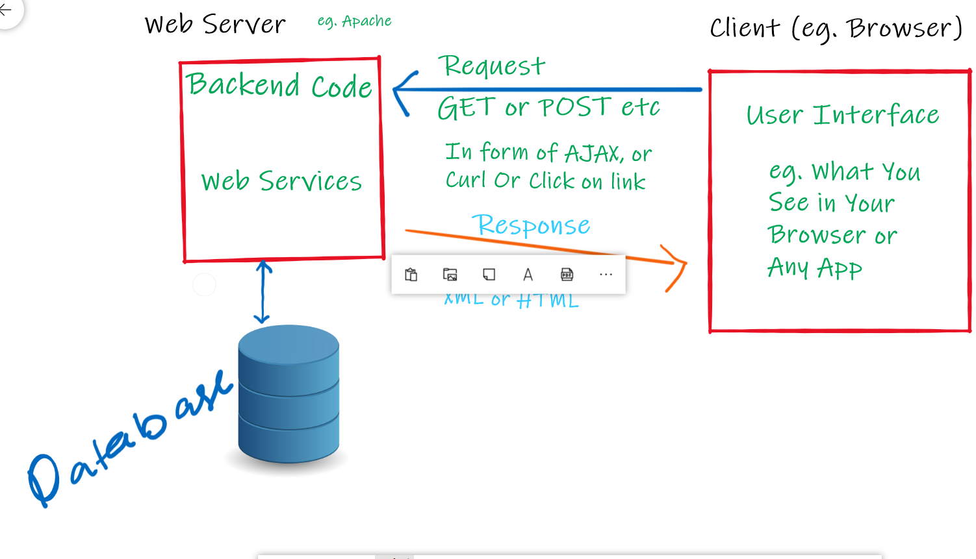

Slide 4
Client Side and Server Side are two different things.
Both are not connected in any way but interact to each other using Request-Response method.
Generally Client sends request to server and server responds accordingly. Server can not send any data to client until it asks server to respond.
If you want that server should send data to client without asking (eg. Getting message of facebook or whatsapp) then you can use websockets for two way communications.

Slide 5
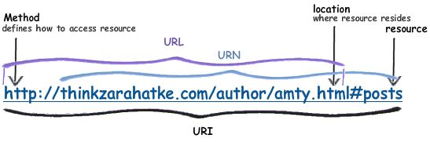
How Web Server Works
Set up a server(Apache or Nginx) with some framework (Django, Node + Express JS etc) which will accept requests from client and process your backend code according to request and respond to client.
You have to setup routing(URLs, path) on which requests will come to server.
Map those URLs to some function in your backend code which will triggered to handle request on specific URLs.

Slide 6
What is Backend?
In WebApp there are two things Front-end and Backend.
Front-end is what user of website or App see.
Backend is what user does not see and mainly runs on server.
Backend consists of Server side code, Database and other micro-services.
All the logics, authorization, database management or connection should be done in Backend. Why?

Slide 7
Options for Backend
Frameworks
Django (Popular, effective and easy) – Used by Pinterest, Dropbox, Quora etc
It uses python which is used in different fields so opens opportunity to use ML or Data Science in Your webapp.
NodeJS (New, Good for apps like gaming) – Used by Walmart, Netflix etc.
It uses Javascript which is very popular and useful.
DataBases
MySQL, MongoDB, DynamoDB etc.

Slide 8
What is Front-end ?
This is what users of website interact with.
Front-end consists of User-Interface and actions taken by users.
To develop front-end in webapp, You must know basics (HTML, CSS, Javascript).
HTML is the structure of web page (like skeleton in human body), CSS decides the look of website (like skin, clothes and makeup), and Javascript handles the actions of user.
Note – Learn these basics in your initially beginner stage to be efficient in future. Do not run after many libraries(Jquery, vanilla etc) which eases your development initially.
Learning and using libraries is very easy if you know basics but vice-versa is not true.

Slide 9
How Client and Server interacts?
Different protocols(http, https, ftp, rtsp etc) are followed to establish communication between client and server.
Different methods are used like GET request, POST request.
Either opens a new webpage or request server for response asynchronously using AJAX or websockets.
Note – Client and server are two different things but you can get confused sometimes when you see php(backend) and HTML, css, JS(Front-end) code in same file.

